Slide 1
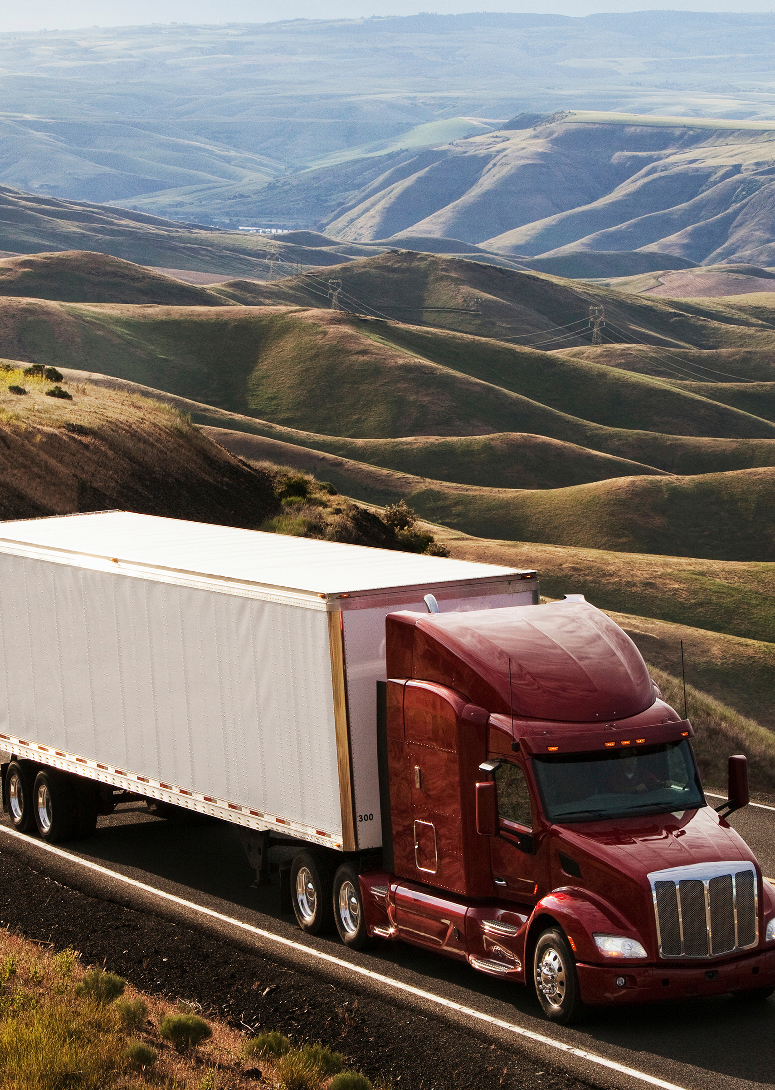
Operations Analytics (DAMO - 610) Transportation Supply Chain Optimization
UNIVERSITY OF NIAGARA FALLS
Professor
Cosimo Girolamo
Group – 4
Dhruv Patel (NF1000200)
Jay Solanki (NF1019757)
Nancy Alkari (NF1009349)
Prashant Thummar (NF1009781)

Slide 2
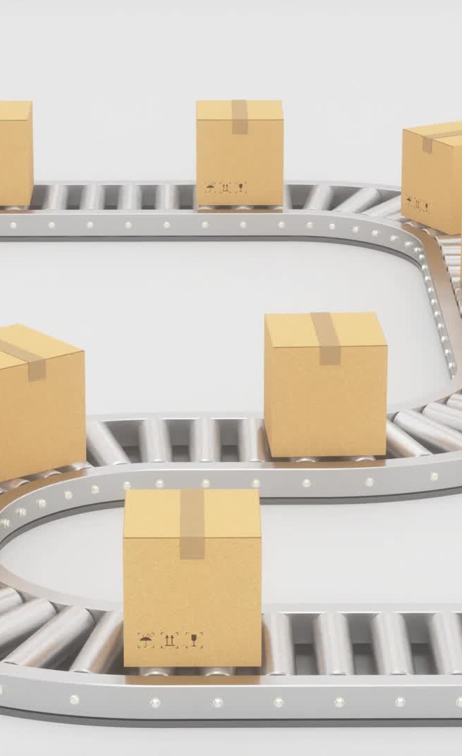
Introduction
Challenge: Balancing cost factors such as ordering, purchasing, holding inventory, and transport.
Approach: MILP model integrating supplier selection, inventory management, and vehicle routing.
Objective: To minimize costs while ensuring that supply chain constraints (demand, inventory, vehicle capacity) are met.

Slide 3
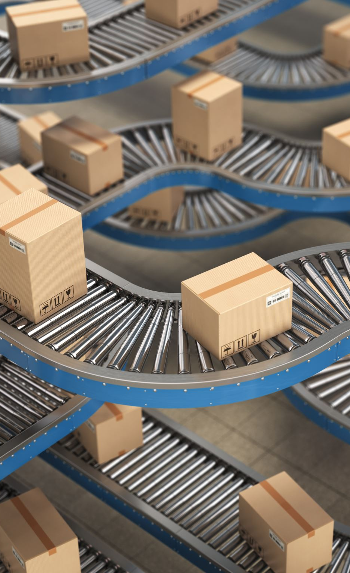
Original Model: "Modeling and Analysis of Multiple-Supplier Selection Problem with Price Discounts and Routing Decisions" by Çabuk & Erol, 2019.
Key Issues Addressed:
Supplier selection
Bulk purchase discounts
Inventory management
Vehicle route planning
Reason for Choosing the Problem: Reflects real-world supply chain complexity, making it a perfect example to optimize using OR-Tools.

Slide 4
Model Implementation
Sets and Indices:
I: Suppliers (4 suppliers)
J: Components (4 components)
T: Time periods (3 periods)
F: Vehicles (2 vehicles)
K: Discount intervals (4 intervals)
Parameters:
Demand: Demand for components over time
Supply: Maximum capacity of suppliers for each component
Price: Base price of components from each supplier
Discount Ratio: Discount offered by suppliers based on order volume
Transport Costs: Cost per distance traveled by vehicles

Slide 5
Objective Function
Goal: Minimize the total costs, which include:
Purchase Costs: Calculated using the discounted price of components.
Ordering Costs: Cost associated with placing an order from suppliers.
Inventory Holding Costs: Cost of holding inventory over time.
Transportation Costs: Fixed vehicle costs and distance-related transport costs.
Cost Type | Components | Calculation Formula
Purchase Cost | Discounted price for each component from suppliers | Total = Σ Vit[i][t]
Ordering Cost | Fixed cost of placing an order per supplier | Total = Σ X[i][t] * ordering_cost[i]
Inventory Cost | Cost of holding inventory per component | Total = Σ Ivar[j][t] * holding_cost[j]
Transportation Cost | Cost of transporting goods using vehicles | Total = Σ Y[f][t] * fixed_vehicle_cost + Σ Rf[f][t][m][n] * transport_cost_per_km

Slide 6
Constraints
Inventory Balance: Ensure that inventory at each period balances demand and supply.
Supplier Capacity: Limits on how much each supplier can provide in each period.
Discount Trigger: Apply discounts only if the order volume exceeds a predefined threshold.
Vehicle Capacity: Ensure that the weight of the items does not exceed the capacity of the vehicles.
Routing Constraints: Vehicles must complete the routes and return to the depot.
Constraint Type | Explanation | Mathematical Formulation
Inventory Balance | Ensure no excess or deficit in inventory | Ivar[j][t+1] = Ivar[j][t] - demand[j][t] + Σ Q[i][j][t]
Supplier Capacity | Orders cannot exceed supplier capacity | Q[i][j][t] ≤ supply[i][j][t]
Discount Conditions | Apply discounts only if orders meet minimum limits | Tit[i][t] ≥ discount_limit[i][k] * U[i][t][k]
Vehicle Capacity | Ensure vehicles do not exceed weight limits | Σ Q[i][j][t] * unit_weight[j] ≤ vehicle_capacity * Y[f][t]

Slide 7
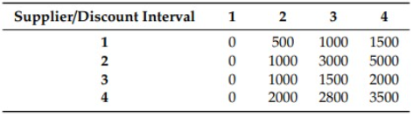
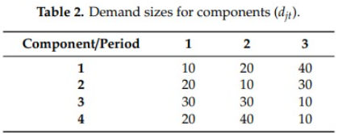
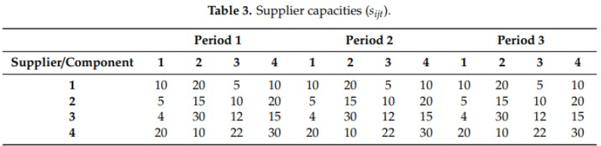
Testing with Synthetic Data
Scenario: Using synthetic data to simulate real-world conditions.
Data Summary:
4 components, 4 suppliers, 3 time periods, and 2 vehicles.
Demand varies between 10 to 40 units per component per period.
Prices and discounts vary across suppliers.

Slide 8
Output:
Metric | Details
Total Cost | $4,625.00
Demand vs Supplied | Component 1: 70 / 30 (−40) Component 2: 60 / 30 (−30) Component 3: 70 / 60 (−10) Component 4: 70 / 60 (−10)
Vehicle Routes (Used) | Period 1: V1 → 2 → 3 → 4 V2 → 4 → 3 → 2 Period 2: V1 → 2 → 3 → 4
Vehicle Usage | V1: Used in Periods 1 & 2V2: Used in Period 1 only
Insight | Supply shortages remain across all components despite optimal routing and discounts. Indicates binding constraints due to reduced vehicle capacity or supplier limits.

Slide 9
Sensitivity Analysis
Purpose: Analyze the impact of variations in key factors like demand, transport costs, vehicle capacity, and holding costs.
Findings:
Peak Demand: Higher demand increases total cost and causes supply shortages.
Transport Cost: An increase in transport cost directly increases the overall cost.
Holding Costs: Changes in holding costs have minimal impact as inventory levels are low.
Scenario | Demand | Transport Cost | Vehicle Capacity | Impact
Peak Demand | Increased Demand | Same | Same | Increased Cost & Shortages
Higher Transport Cost | Same | Increased | Same | Increased Cost
Lower Vehicle Capacity | Same | Same | Reduced | Higher Inventory & Costs

Slide 10
OUTPUT:
Scenario | Total Cost | Component 1 Supplied | Component 2 Supplied | Component 3 Supplied | Component 4 Supplied | Inventory Used | Notes
Baseline | 4 332.50 | 30.00 | 30.00 | 60.00 | 60.00 | ❌ No | Reference scenario
Peak Demand | 6 101.00 | 50.00 | 50.00 | 80.00 | 80.00 | ❌ No | High unmet demand
Higher Transport Cost | 5 682.50 | 30.00 | 30.00 | 60.00 | 60.00 | ❌ No | Cost rose due to transport
Lower Vehicle Capacity | 4 625.00 | 30.00 | 30.00 | 60.00 | 60.00 | ✅ Yes | Extra inventory used
Higher Holding Cost | 4 332.50 | 30.00 | 30.00 | 60.00 | 60.00 | ❌ No | Same as Baseline
Higher Ordering Cost | 4 452.50 | 30.00 | 30.00 | 60.00 | 60.00 | ❌ No | Minor increase in cost

Slide 11
Model Extension
Distance is the sum of all vehicle‐km across Periods 1–2 (no activity in Period 3).
CO₂ = 0.5 kg CO₂/km × Total Distance.
Δ Cost = (Costₛₜₑₙₐᵣᵢₒ – Cost_baseline) / Cost_baseline × 100%.
Scenario | Total Cost (₹) | Total Distance (km) | CO₂ Emissions (kg) | Δ Cost vs. Baseline
Baseline | 4 332.50 | 270 | 135 | –
Peak Demand | 6 101.00 | 360 | 180 | +40.8 %
Higher Transport Cost | 5 682.50 | 270 | 135 | +31.2 %
Lower Vehicle Capacity | 4 625.00 | 270 | 135 | +6.8 %

Slide 12

Conclusion
Key Insights:
Demand Variability: Flexibility in capacity planning is essential, especially during peak demand periods.
Transport Costs: Optimizing transportation routes and costs can significantly reduce overall expenses.
Holding Costs: Should be monitored as inventory levels change, but they had minimal impact in this case.

Slide 13
THANK YOU

